Slide 1
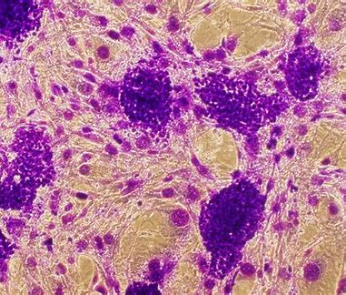
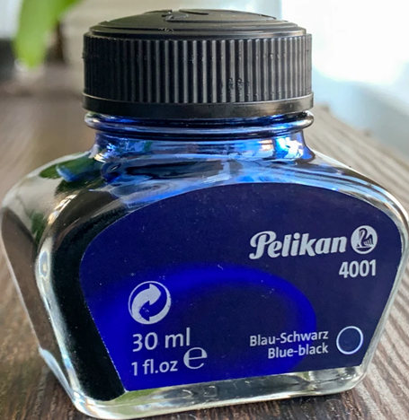
BT233 – General Microbiology Laboratory
Simple Staining

Slide 2
Conclusions from Last practical:
The Microscopic field decreases with Magnification
The light intensity needs to be increased with magnification
The working distance of the microscope decreases with magnification
The resolving power of the microscope increases with magnification
The bacteria either motile or non-motile
The bacteria are minute and colorless, impossible to be seen them by the naked eyes and hard to see under the microscope

Slide 3
Because the bacteria are minute and colorless, impossible to be seen them by the naked eyes and hard to see under the microscope, we need to increase the visibility of the bacteria under the microscope by increasing the contrast
We can increase the contrast by Staining

Slide 4
Staining
Staining as a procedure it needs:
A- Materials (Stains)
B- Technique

Slide 5
Components of Stain
Stain is an inorganic compound which mainly composed of the following :
Stain (Dye) = Chromogen + Auxochrome
Chromogen =Benzene ring + chromophore (give color to chromogen )
Auxochrome: Gives charge to chromogen
So, the chromogen may be become positive or negative

Slide 6
- Benzene ring is the colorless part of a dye and it is basic structural component of a dye.
- Chromophore is the functional group of a dye that gives color to the stain.
- Auxochrome is the group that gives ionic property to the stain.

Slide 7
Types of Stain
- According to the charge of stain (Chromogen), there are three types of stain
1. Acidic stains (Anionic stains, Negative charge)
Such as: Nigrosine, India ink, Eosin
2. Basic stains (Cationic stain, Positive charge): such as:
Crystal violet, Methylene blue, Safranine,
Carbolfuchsin, Malachite green
3. Neutral stains(has no net charge)

Slide 8
Acidic stain (Anionic stain)
- Chromogen of acidic stain is negatively charged. So, it is also known as Anionic stain
- Acidic stain are used to stain the positively charged components such as background .

Slide 9
The best dye for staining of the bacteria is Basic dye, Why?
Acidic stain can’t stain the bacterial cell due to repulsion between the negative charge of stain and that of bacteria (The net charge of bacteria is negative due to genetic material)

Slide 10
Basic stain (Cationic stain)
Chromogen or colored part of basic stain is positively charged. So, it is also known as cationic stain.
Basic stain are used to stain negatively charged components such as bacterial cell due to attraction between positive charge the dye and the negative charge of bacteria (net charge of bacteria is negative).
Examples: methylene blue, safranin, malachite green, basic fuschin, crystal violet, and Carbolfuchsin

Slide 11
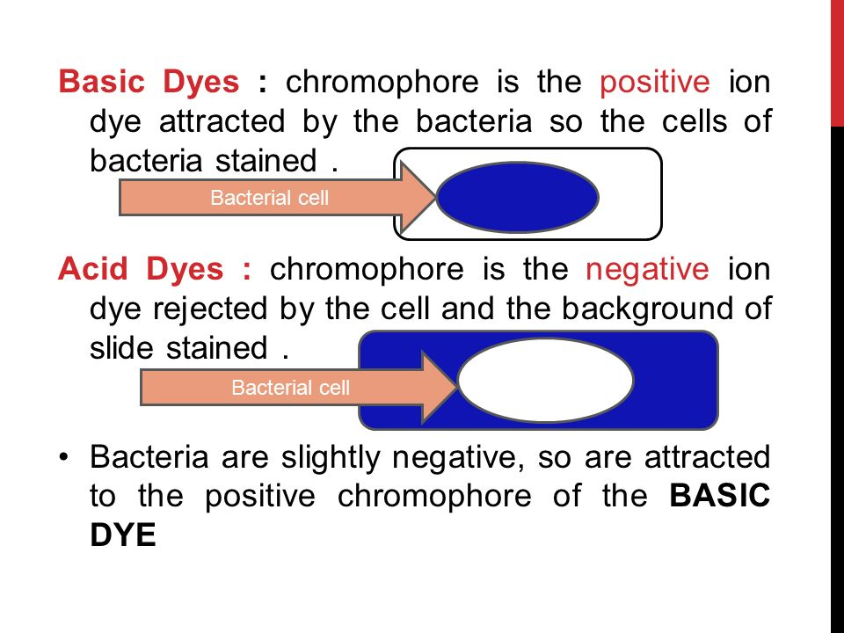

Slide 12
Neutral stain
- Neutral stains are a salt of acidic and basic stain.
- Examples: giemsa stain.

Slide 13
Staining techniques
** According to the purposes, staining techniques divid to three types:
1. Simple staining
2. Differential staining
3. Structural staining

Slide 14
Simple stain: Uses only one dye, and this dye reacts similarly with all types of bacteria.
Indirect Simple Stain
(Negative or background stain)
- Stain background, so Acidic dye must be used.
Direct Simple Stain
- Stain bacteria itself, so Basic dye must be used.

Slide 15
Differential staining Uses more than one dye, and these dyes react differently with different types of bacteria.
Gram staining
1. Gram positive bacteria
2. Gram negative bacteria
Acid - Fast staining
1. Acid fast bacteria
2. Non acid fast bacteria

Slide 16
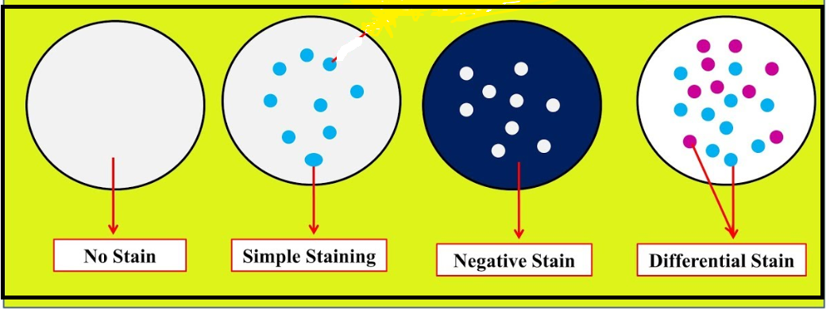

Slide 17
Structural Staining Use One dye or more to stain certain structure within bacteria
Bacteria structure that can be stained:
Capsule
Cell Wall
Endospores
Flagella
Ribosomes
Genetic material

Slide 18
All staining techniques needs Smear Preparation EXCEPT
Negative Staining (Also called Background or indirect
staining)

Slide 19
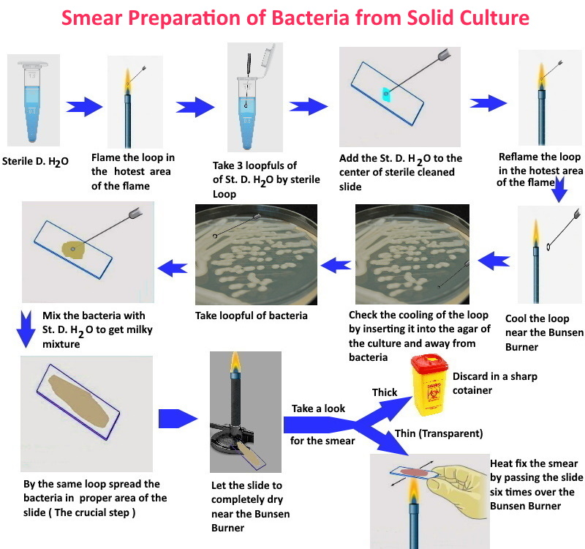

Slide 20
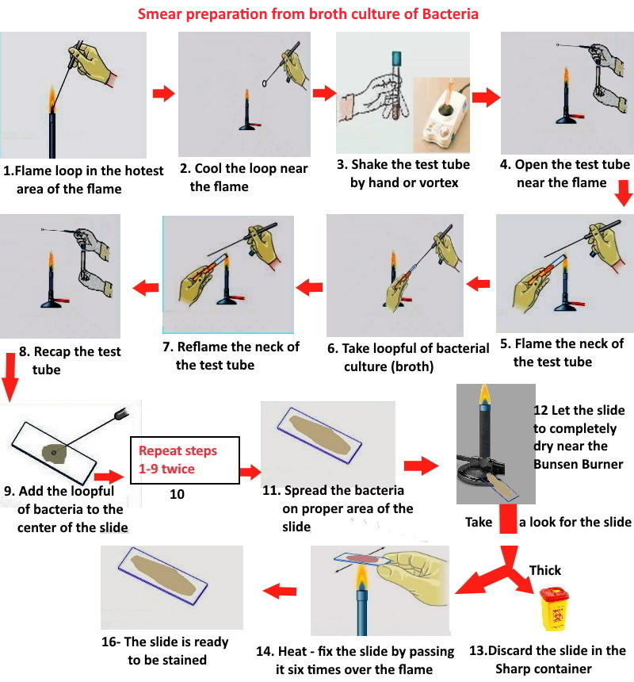

Slide 21
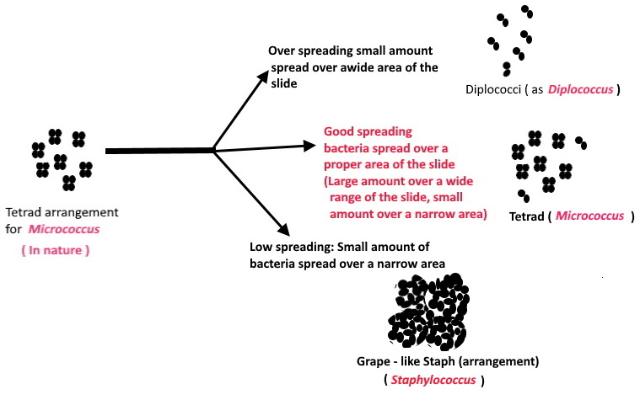
During smear preparation
You spread the bacteria over a proper area of the slide, in order to have at least 70% of the cells arrange look like the arrangement of the bacteria in nature.

Slide 22
Check the cooling of the loop by inserting it into the agar of the culture from where we will take the bacteria and away from bacteria to:
Prevent scattering of the bacteria in the lab air
(indoor air)
Prevent infection of ourselves
Prevent killing of bacteria
Heat fixation of the smear to:
a- Kill the bacteria
b- Fix the bacteria to the slide
So, it will not wash out during washing the slide in staining

Slide 23
During drying of the smear: Don’t blow on the slide, Don’t wave the slide on the air.
JUST Let it to dry near the Bunsen Burner

Slide 24
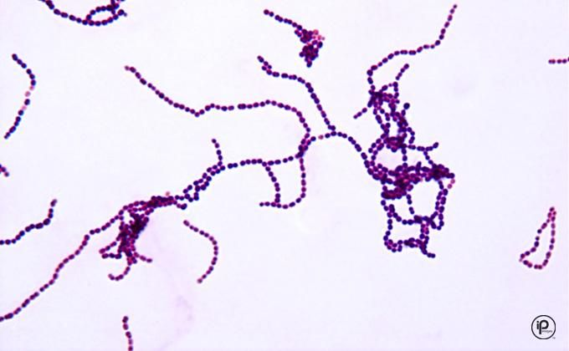
Direct Simple Stain
It is used to stain bacteria itself, while the background remains colorless.
- Cation (Basic) dye should be used to stain bacteria itself.

Slide 25
Direct Simple Stain (Materials)
Materials:
1. Loop
2. Slides
3. Crystal violet or any Basic dye
4. Sterile distilled water
5. Bacteria
Note: you should work under aseptic condition

Slide 26
Direct Simple Stain (Method)
1. Smear Preparation
2. Load the smear with basic dye (as crystal violet)
3. Wash gently with tap water, prevent dripping of water directly over the smear
4. Blotting with filter paper
5. Observation under Microscope

Slide 27
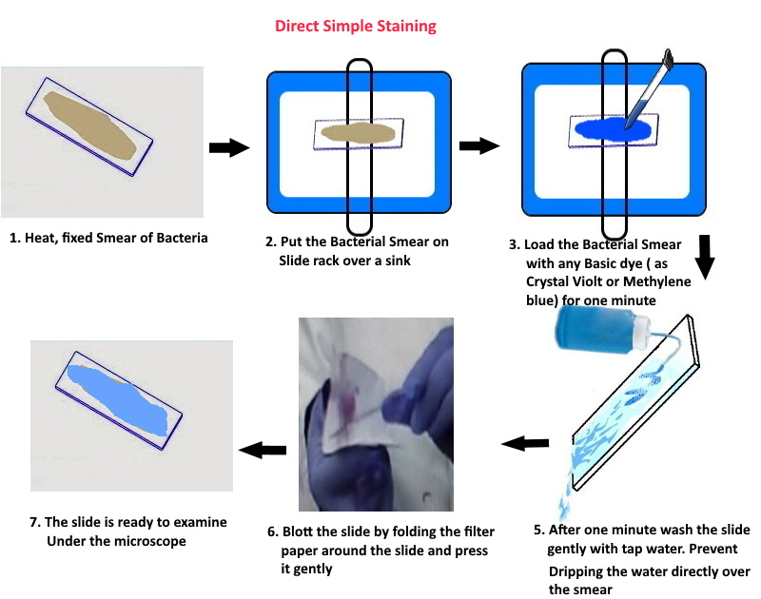

Slide 28
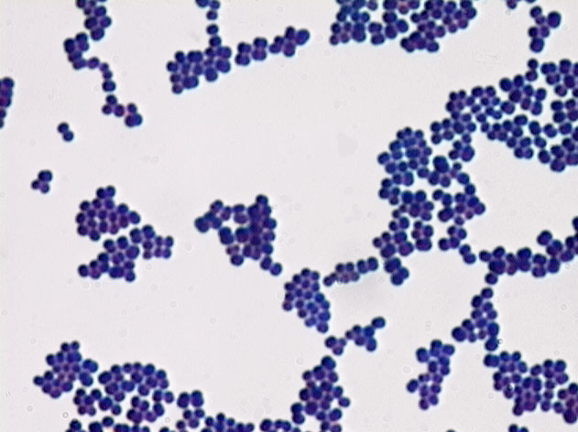
Direct Simple staining of Bacteria

Slide 29
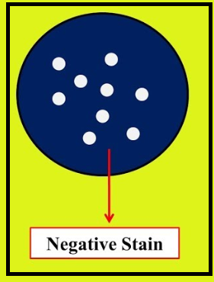
Indirect Simple Stain
It is used to stain the background, while bacteria
remain colorless.
It is also called Negative or background stain.

Slide 30
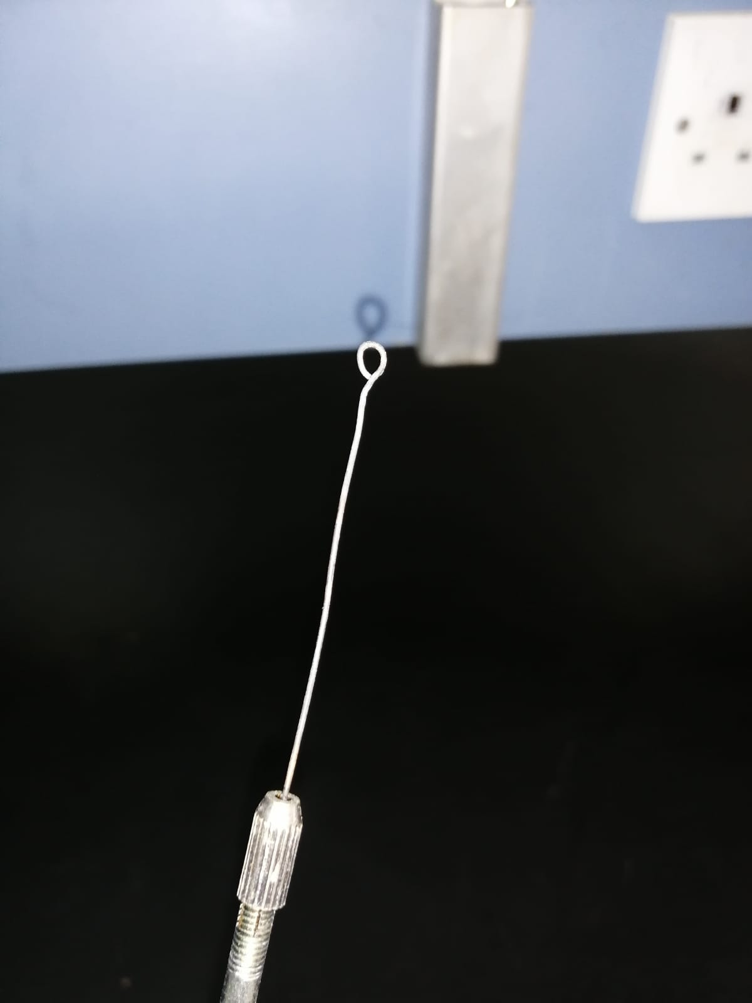
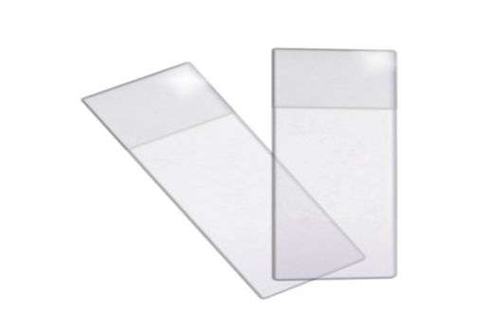
Indirect (Negative, Background) Staining
Materials:
Bacterial Culture (Bacillus)
Inoculating Loop
Two sterile, cleaned microscopic slides
Dye (Stain)

Slide 31
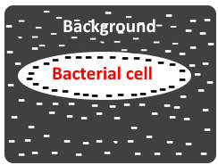
There are two types of the stain ( Dye ) can be used to stain the bacteria through indirect simple staining, these are:
A. Acidic dyes: as Nigrosine and India ink, the negative
charge of this dye repelled by the negative charge of
the bacteria. So, the dye will not Access the cell and
remain outside the cell to stain the background not
the bacterial cells.

Slide 32
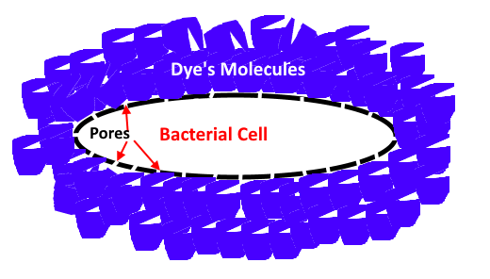
B. Stain with large molecular size: as Pelikan 4001
This dye has large molecules, larger than the pores in
the cell wall of bacteria. So, they can’t penetrate
to the bacterial cells (Can’t access the bacterial cells)
and remains in the background to stain it.

Slide 33
Why we need to stain bacteria through negative staining?
In order to:
Stain the bacteria that we can’t stain them by other staining techniques(other than negative staining).
e.g. Spirilli bacteria
To study the natural shape and size of the bacteria, because:
A. No stain enter the bacteria, so the cell will not enlarge and
remain normal
B. No heat applies to the preparation, most of the bacterial cell
is water. When heat apply to the cell, the water evaporate
and the cell became smaller. This mains in negative staining
there is no heat and the cell remains normal.

Slide 34
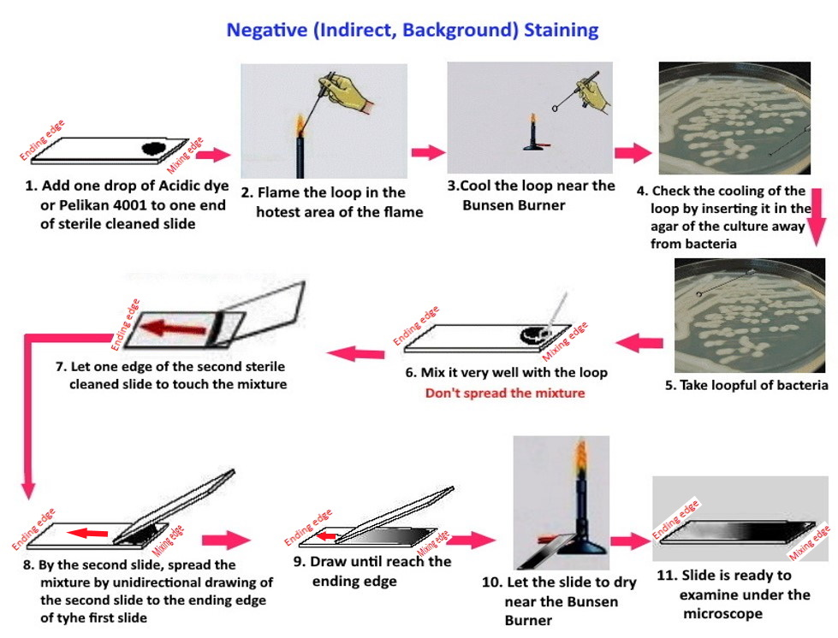

Slide 35
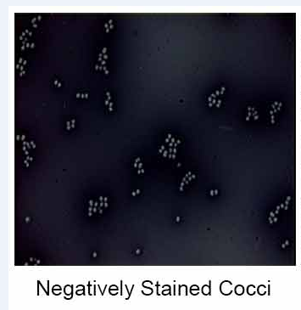

Slide 36
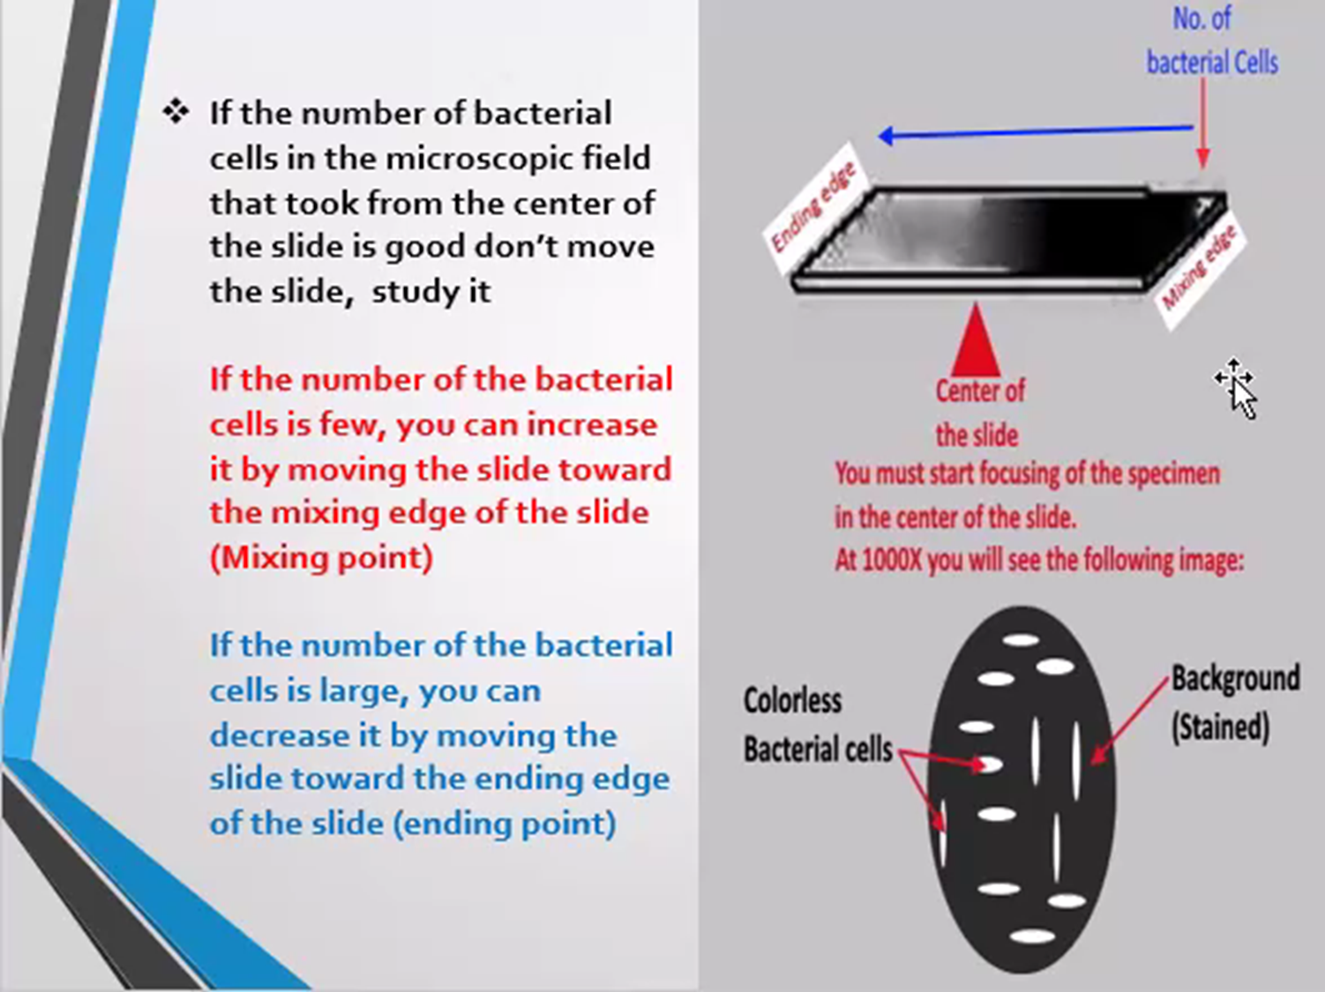

Slide 37
The End

